Slide 1
Project 3: Initial Iteration
Group : CAACC

Slide 2
Old News
Issues:
Use Case Document/Diagram:
-Missing a use case for login
(Added use case and updated diagram)
-Needed an “unregistered user” actor
Domain Model:
-Missing class for invitations
-Multiplicity error on Piece and Tile
(Added and updated associations)
Glossary:
-Missing conceptual class descriptions
(Added descriptions for classes and attributes)
Fixing Our Mistakes
Notes:
Don’t touch on the issues here, just acknowledge them

Slide 3
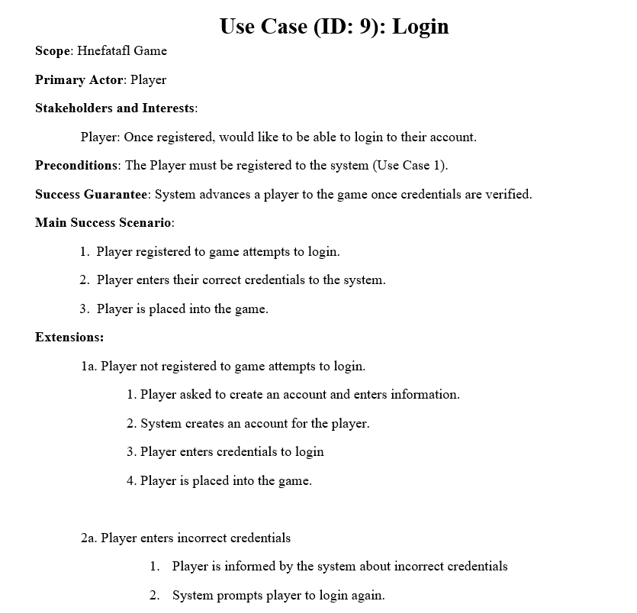
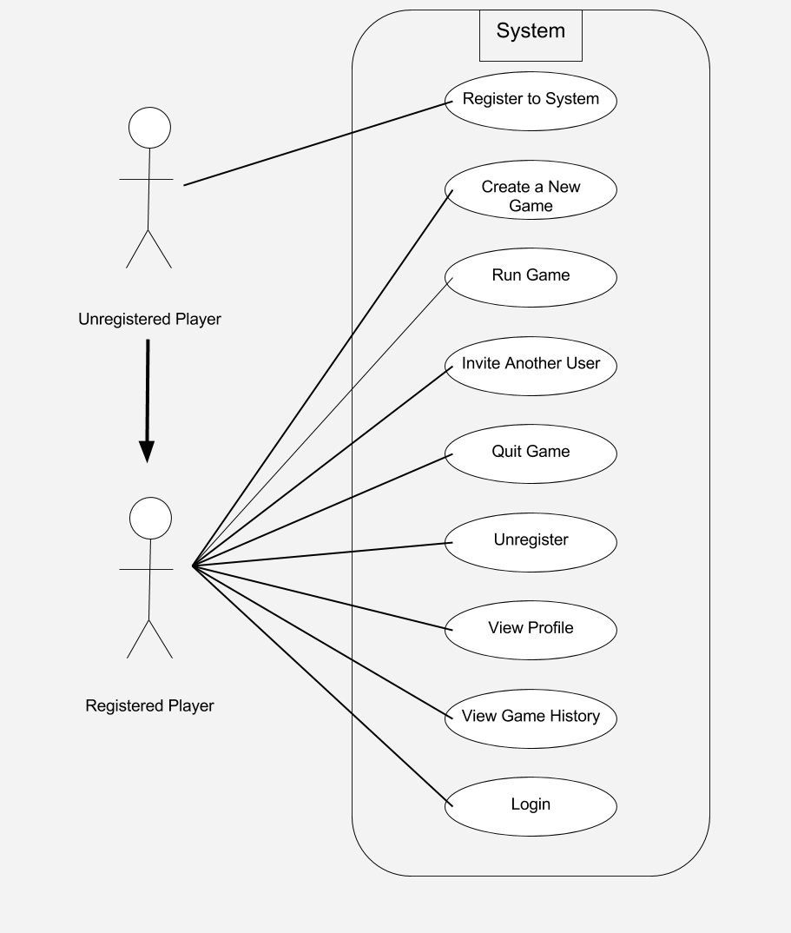
Updated Use Case Document and Diagram
Notes:
Talk about issues with Document (added use case).
Talk about adding unregistered player and login

Slide 4
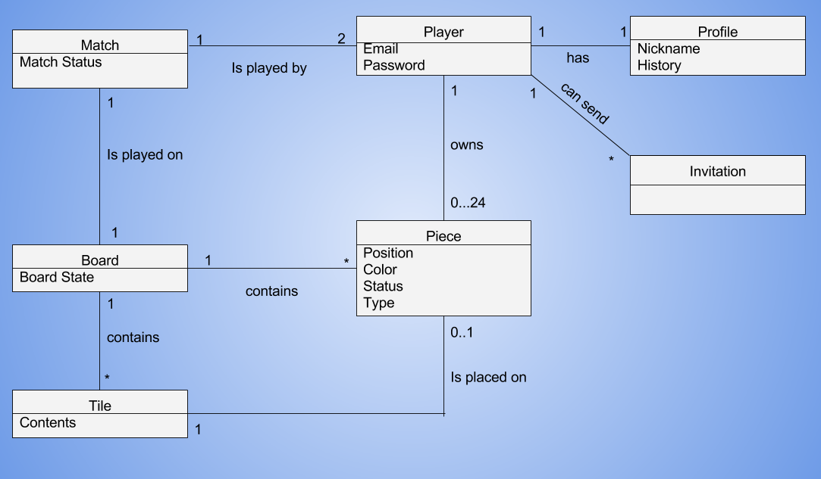
Updated Domain Model
121
Notes:
Talk about invitation and multiplicity

Slide 5
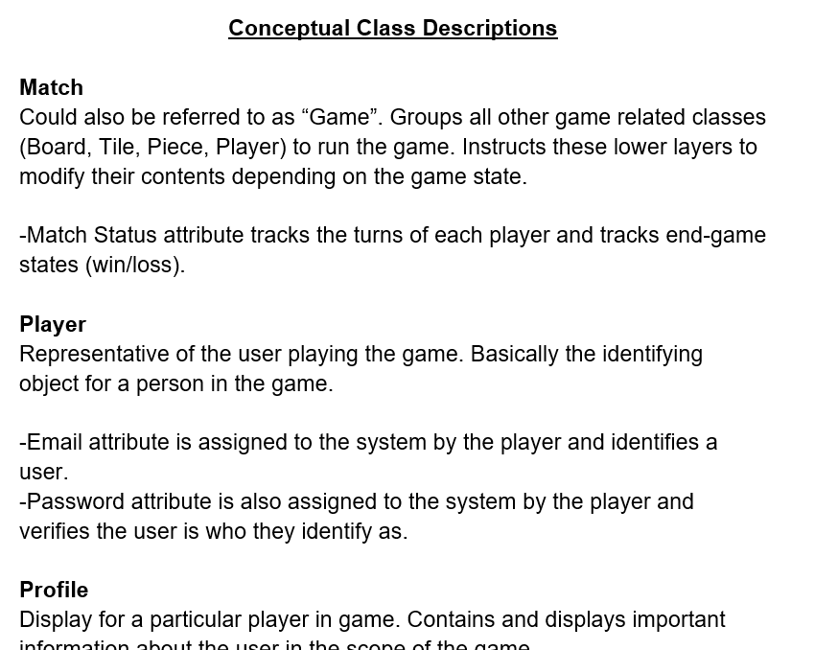
Updated Glossary (snapshot)
Notes:
Just touch on adding class descriptions and attributes

Slide 6
New Documents
Including:
Sequence Diagrams
-Modeling piece movement, capture flow, and board initialization.
Design Class Diagram
Testing Document (System Tests)
Development Manual
Traceability Link Matrix
(with hopefully fewer mistakes)
Notes:
Don't mention anything but something about the title

Slide 7
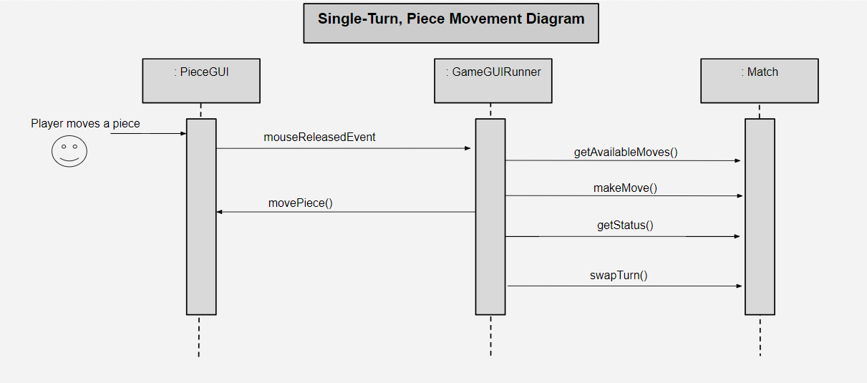
Sequence Diagram #1
Notes:
Talk about what this diagram shows, not how it does it

Slide 8
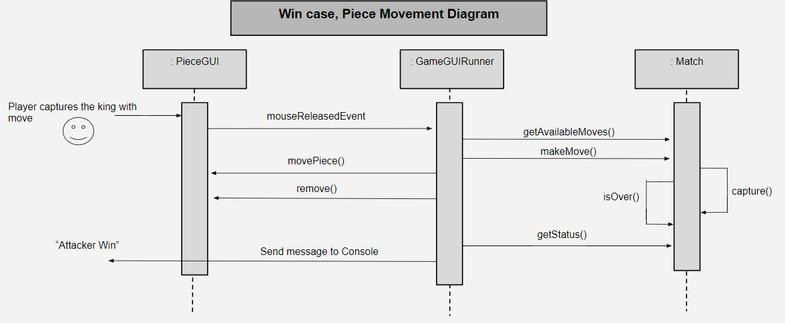
Sequence Diagram #2
Notes:
Talk about what it shows, not how its done

Slide 9
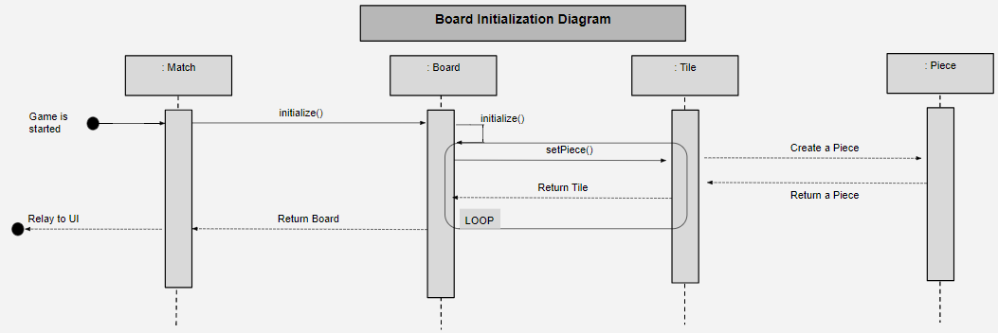
Sequence Diagram #3
Notes:
Talk about what it shows, not what it does

Slide 10
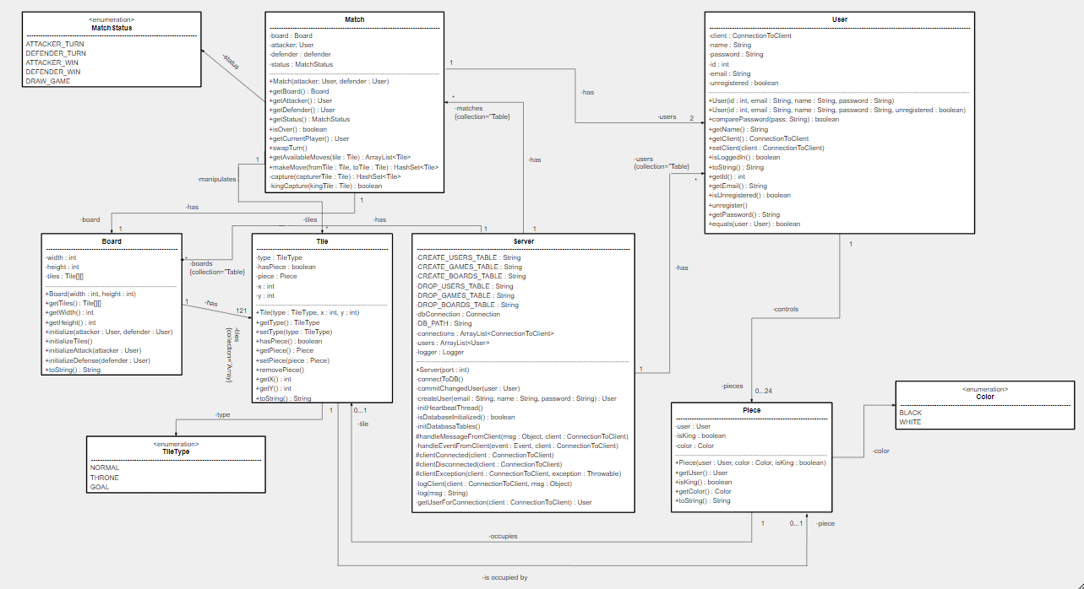
Design Class Diagram
(Can’t expect anyone to be able to read that though…)
Notes:
Mention what this is

Slide 11
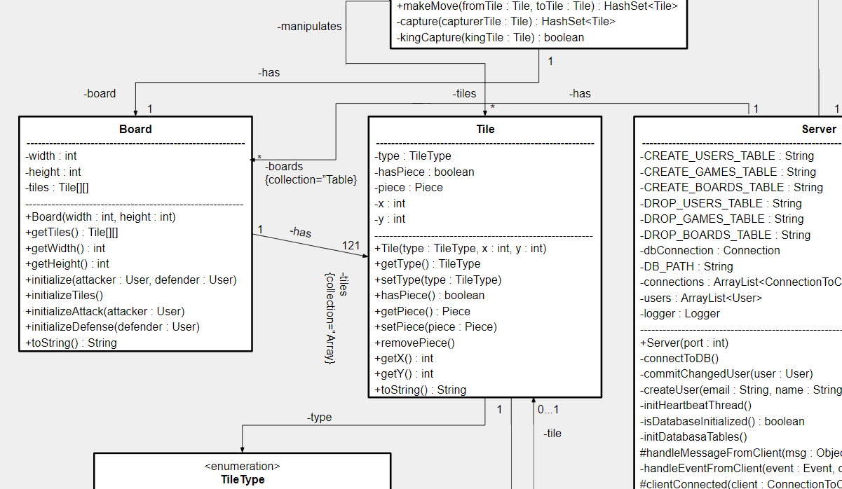
So here’s a snapshot...
Notes:
Describe what this is

Slide 12
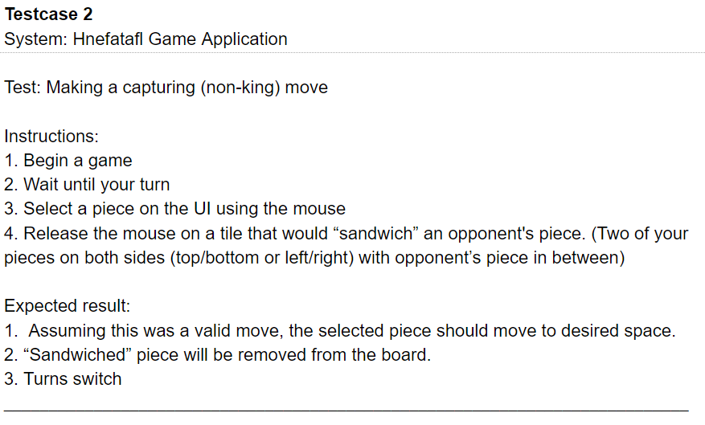
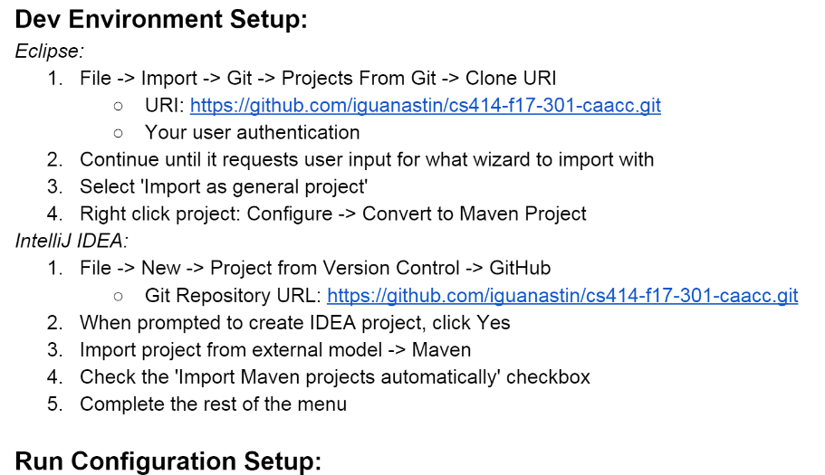
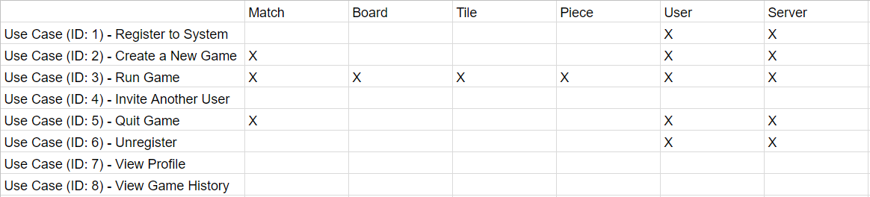
Test Document, Development Manual, and TLM
Only a small glimpse here...
Notes:
Touch on the intents of each

Slide 13
Tools and Tech Utilized
Eclipse/Intellij
Maven
JavaFX
H2 Database
JUnit
SLF4J
Notes:
Don't mention anything but something about the title

Slide 14
Now for a Demo...

Slide 15
Questions?

